Slide 1
Session 1

Slide 2
Agenda
Net Core (v7)
.Net RoadMap
Version Control System (GIT)
Microsoft Identity (EntraID)

Slide 3
.Net Core (v7)
Introduction to .Net 7
Key Features
IDEs
Deployments
Performance

Slide 4
Introduction to .Net core
.NET Core is a free, open-source, and cross-platform framework developed by Microsoft for building modern, high-performance applications. It can run programs written in multiple languages with C#, F# and visual basic.
The .NET platform has been designed to deliver productivity, performance, security, and reliability

Slide 5
Key Features
Cross-Platform Compatibility:
.NET Core is its ability to run on multiple platforms, including Windows, macOS, and Linux.
Performance Optimization:
NET Core is engineered for performance, with improvements in areas such as speed, memory usage, and scalability. Open-Source
Embracing the principles of open-source development, .NET Core is available under the MIT license (Massachusetts Institute of Technology) on GitHub.
Unified Development Stack
With .NET Core, Microsoft aims to provide a unified development stack for building a wide range of applications, including web, desktop, cloud, IoT, and mobile apps.

Slide 6
IDEs
Integrated Development Environments (IDEs) commonly used for .NET Core development:
Visual Studio
Developed by Microsoft, Visual Studio is a comprehensive IDE with robust features for .NET development. It offers powerful code editing, debugging, and testing capabilities, along with integration with Azure services for cloud development
Visual Studio Code (VS Code):
Visual Studio Code is a lightweight, open-source code editor developed by Microsoft. It provides excellent support for .NET Core development through extensions, including IntelliSense, debugging, and Git integration.

Slide 7
Deployments
Self-contained Deployment
With self-contained deployment, all dependencies, including the .NET Core runtime and libraries, are bundled with the application. This allows the application to be deployed as a single executable file that can run independently on the target system
Docker Containers
Docker containers provide a lightweight and portable way to package and deploy .NET Core applications along with their dependencies. By containerizing the application, you can ensure consistent deployment across different environments, including development, testing, and production.

Slide 8
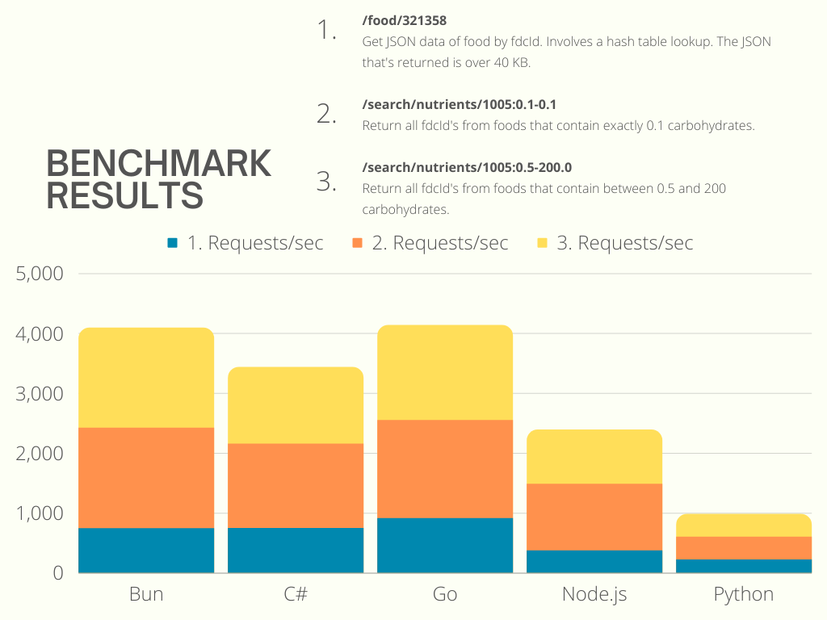
Performance

Slide 9
.net RoadMap

Slide 10
Version Control Systems (GIT)

Slide 11
GIT
Introduction to Git
Collaboration
Key Concepts
Git tools and platforms

Slide 12

Introduction to GIT
Git is a distributed version control system (DVCS) that helps us track changes in our codebase, collaborate with others, and manage different versions of our project.
Git stores the full history of our project on your local machine, allowing you to work offline and enabling faster performance.

Slide 13
Git Collaboration
Collaboration in Git involves multiple developers working together on the same project, sharing their changes, and coordinating their efforts to produce a unified codebase.

Slide 14
Key Concepts
Repository: A repository, or repo, is a collection of files and folders managed by Git. It contains the entire history of your project, including all the changes made over time.
Commit: A commit represents a snapshot of your project at a specific point in time. Each commit records the changes made to the files in your repository along with a commit message describing the modifications.
Branch: A branch is a parallel version of your repository that diverges from the main line of development (usually called the "master" branch). Branches allow you to work on new features or experiments without affecting the main codebase.
Merge: Merging is the process of combining changes from one branch into another. It's commonly used to integrate the changes made in feature branches back into the main branch of the project.

Slide 15
Basic GIT Commands
git init: This command is used to start a new repository.
git clone: This command is used to obtain a repository from an existing URL.
git add: This command adds a file to the staging area.
git commit: This command records or snapshots the file permanently in the version history.
git status: This command lists all the files that have to be committed.
git log: This command is used to list the version history for the current branch.
git push: This command sends the branch commits to your remote repository.
git pull: This command fetches and merges changes on the remote server to your working directory.

Slide 16
Git Tools and Platforms
GitHub:
GitHub is a web-based platform for hosting Git repositories and collaborating on projects.
It offers features such as issue tracking, pull requests, code review, and project management tools.
GitHub also provides integrations with various CI/CD tools and third-party services.
GitLab:
GitLab is a web-based DevOps platform that provides Git repository management, CI/CD pipelines, issue tracking, and code review tools.
It offers self-hosted and cloud-hosted options, as well as a free community edition

Slide 17
Git Tools and Platforms
Bitbucket:
Bitbucket is a Git repository hosting service provided by Atlassian.
It offers features similar to GitHub and GitLab, including code collaboration, pull requests, and issue tracking.
Bitbucket integrates seamlessly with other Atlassian products, such as Jira and Confluence.

Slide 18
Microsoft Identity

Slide 19
Entra ID
Introduction to EntraID
Collaboration
Key Concepts
Git tools and platforms

Slide 20
Introduction TO Azure
Azure is Microsoft's cloud computing platform and services, providing a wide range of services for building, deploying, and managing applications and services through Microsoft-managed data centers.
common services in Azure:
Compute: Virtual Machines, Azure App Service and Azure Functions
Storage: Azure Blob Storage, Azure File Storag, Azure Queue Storage and Azure Disk Storage
Networking: - Azure Virtual Network, Azure Load Balancer, Azure Application Gateway and Azure VPN Gateway.
Databases: - Azure SQL Database, Azure Cosmos DB, Azure Database for MySQL and Azure Database for PostgreSQL.
Security: - Azure Active Directory, Azure AD B2C (Business to Consumer) and Azure AD B2B (Business to Business)

Slide 21
Introduction TO Entra ID
Microsoft's cloud-based identity and access management service. It helps your employees sign in and access resources securely, whether they're on-premises or in the cloud.
Identity Management: Entra ID serves as the foundation for securing your organization's identity infrastructure in the cloud. It provides features like user account management, single sign-on (SSO), multi-factor authentication (MFA), and self-service password reset.
Single Sign-On (SSO): With Entra ID, users can sign in once and access all the applications they need to do their jobs. Azure AD supports thousands of pre-integrated apps, including popular SaaS applications like Office 365, Salesforce, and thousands of others.
Device Management: Entra ID also provides device management capabilities, allowing you to manage and secure devices that access your organization's resources. This includes features like device registration, conditional access based on device health, and integration with Microsoft Endpoint Manager for comprehensive device management.

Slide 22
types of authentication
Username and Password: The most common form of authentication, where users provide their username (often their email address) and password to sign in to Azure AD and access resources.
Multi-Factor Authentication (MFA): Azure AD supports MFA, which adds an extra layer of security by requiring users to provide additional verification beyond their password. This can include factors like SMS codes, phone calls, mobile app notifications, or biometric verification.
Single Sign-On (SSO): Azure AD provides SSO capabilities, allowing users to sign in once with their Azure AD credentials and access multiple applications without needing to re-enter their credentials. This enhances user experience and productivity while maintaining security.

Slide 23
Authentication and authorization
Authentication and authorization are two fundamental concepts in the field of information security, particularly in the context of controlling access to resources and systems.
Authentication:
Authentication is the process of verifying the identity of an entity, typically a user, system, or device, to ensure that they are who they claim to be. It answers the question, "Who are you?“
Authorization:
Authorization is the process of determining what actions an authenticated user or entity is allowed to perform on a system or resource. It answers the question, "What are you allowed to do?"

Slide 24
THANK YOU
Eng. Anas Matar
+601161842823
Anas.mattar90@gmail.com
https://anasmattar.info/

